Slide 1

Final Project Spark near real-time sentiment analysis
C.N. Chen, Mohan K. Patnam, Bruno Janota
CSCI E-63 Big Data Analytics
Harvard University Extension School
Prof. Zoran B. Djordjević

Slide 2
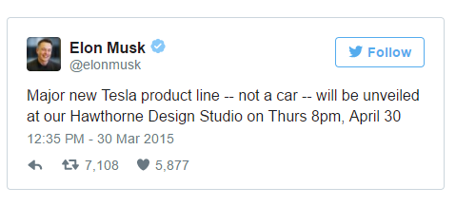
Introduction
Elon Musk made nearly 1B $$ on this single tweet!! http://www.telegraph.co.uk/news/worldnews/northamerica/usa/11505566/Elon-Musks-1bn-tweet-news-of-secret-product-line-sees-Tesla-shares-soar.html

Slide 3
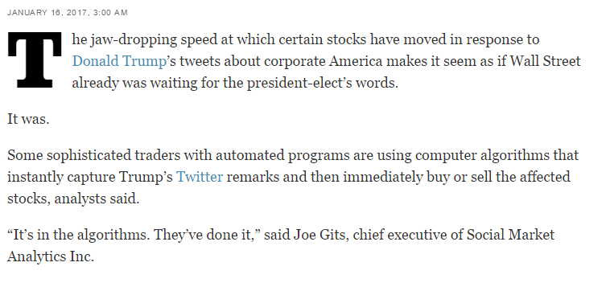
Introduction
When Trump tweets, Wall Street trades - instantly!! http://www.latimes.com/business/la-fi-agenda-trump-tweets-stocks-20170116-story.html

Slide 4
What affects Stock Prices?
Fundamental Factors:
Balance sheet - Assets vs Liabilities
Earnings, Growth etc.
Technical Factors:
Economy, Recession, Inflation
Geo-Political factors etc.
Market Sentiment:
How about Tweets?

Slide 5
Social Sentiment
Does Social Sentiment matter?
Is Social Media an electronic word of mouth?
Is it a leading indicator of stock prices?
How good is the Noise-to-Signal ratio in tweets?

Slide 6
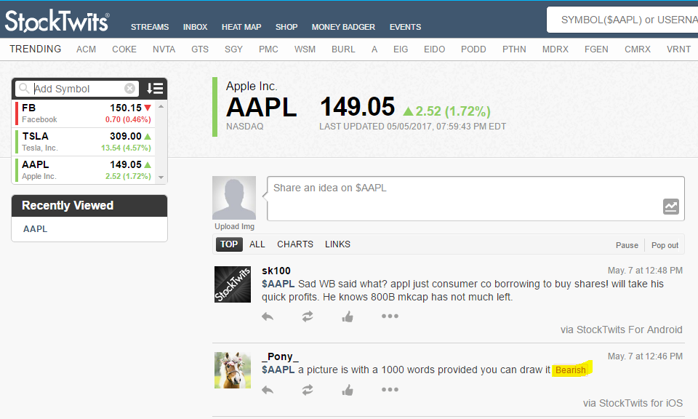
Stock Tweets

Slide 7
Project Statement
Sense the market pulse or social sentiment (Bullish vs Bearish) using near real-time stream of tweets.
(Source: www.StockTwits.com)
A case study of 3 stocks: TSLA, AAPL and FB.
A methodology to build sentiment scores using Bag-Of-Words approach and Naive-Bayes-Classifier.
Regression analysis to predict stock volatility using sentiment scores.

Slide 8
Project Phases
Automate data download and wrangling
Sentiment Analysis-1: Bag-of-Words approach
Sentiment Analysis-2: Naive-Bayes Classifier
Regression Analysis: Sentiment Score vs Stock Price

Slide 9
Data Download and Wrangling
Automate data download and wrangling
StockTwits API: https://stocktwits.com/developers/docs
RESTful API providing JSON responses
Output: CSV files

Slide 10
Bag-of-Words Sentiment Analysis
…
...

Slide 11
Naive-Bayes Classifier
…
...

Slide 12
Regression Analysis
…
...

Slide 13
YouTube URLs, Last Page
Two minute (short):
15 minutes (long):

Slide 14
References
Investopedia - Most followed stocks in stocktwits.com
StockTwits API - https://stocktwits.com/developers/docs
Yahoo! Finance for historical stock prices - AAPL Historical Prices
Bloomberg intraday prices
Dictionary Sources
Naive Bayes Classifier
Tensorflow API - https://www.tensorflow.org/api_docs/python/

